Slide 1
Dicing and Partial Dicing Release of Lithographed Device
Neuralink, US 2023/0382098, 11/30/2023 5/<insert day here>/2024

Slide 2
Background

Slide 3
Outline
Goal: Describe method for fabricating cantilever structure using partial dicing
Embodiments:
Method for fabricating cantilever structure
Cross-sectional views of structures fabricated with and without sacrificial layer
Cross-sectional view of substrate
Top-down views of substrate
Wafer map

Slide 4
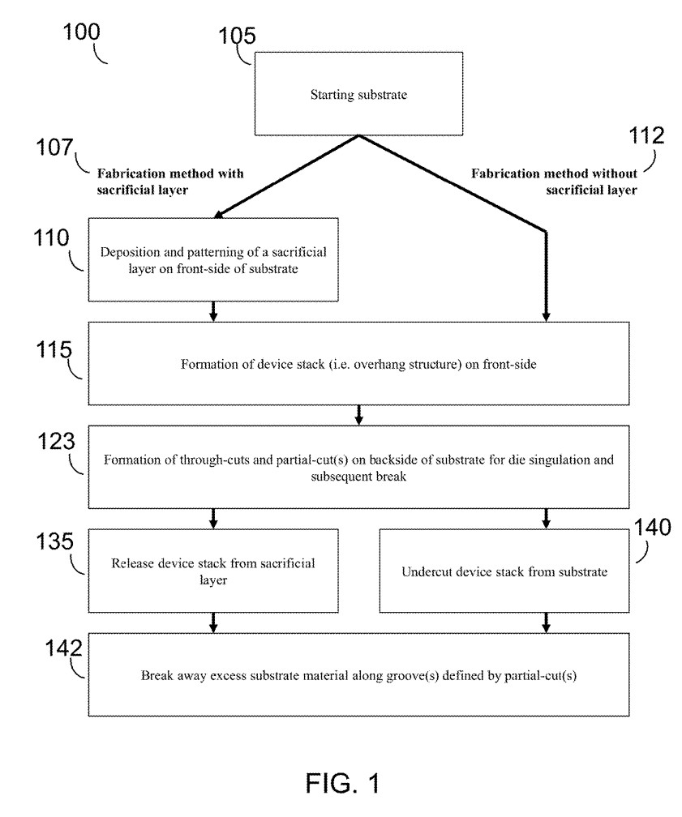
Method for fabricating cantilever structure

Slide 5
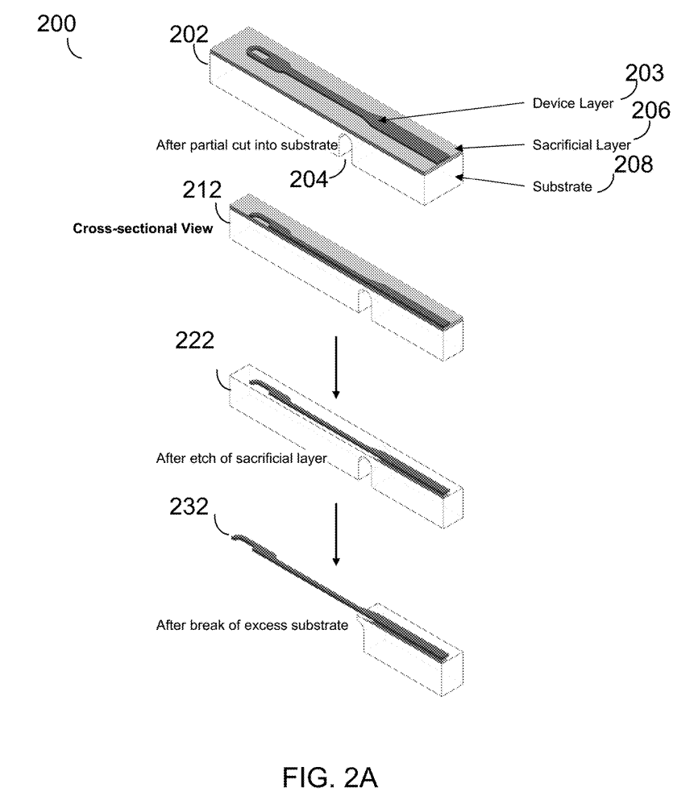
Cross-sectional views of structures fabricated with sacrificial layer

Slide 6
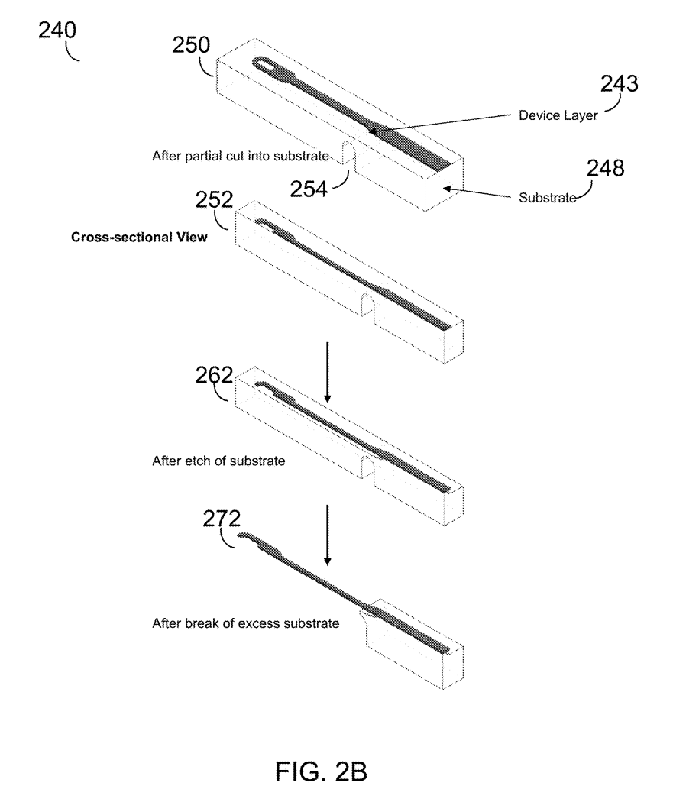
Cross-sectional views of structures fabricated without sacrificial layer

Slide 7
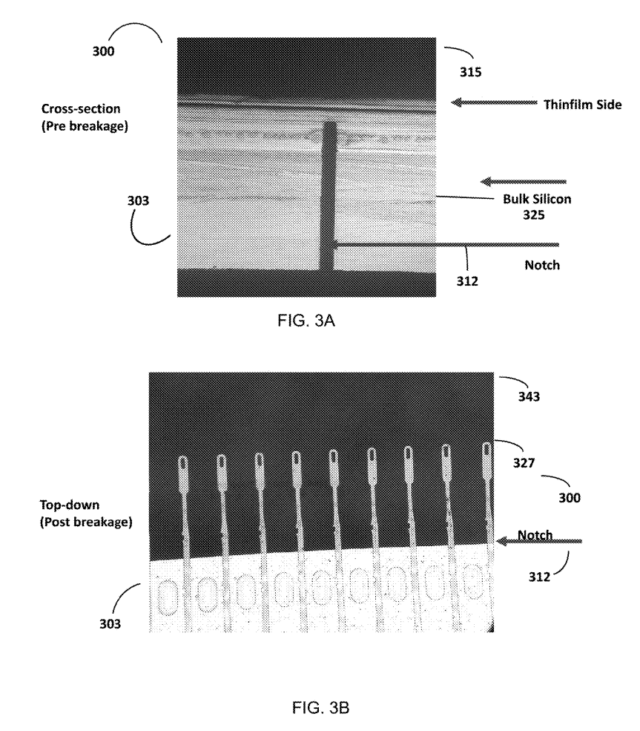
Cross-section view of substrate

Slide 8
Top-down view of substrate

Slide 9
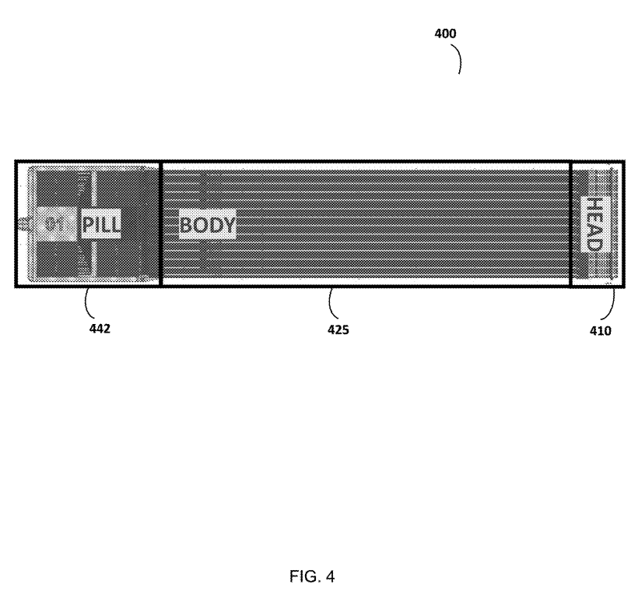
Top-down view of substrate

Slide 10
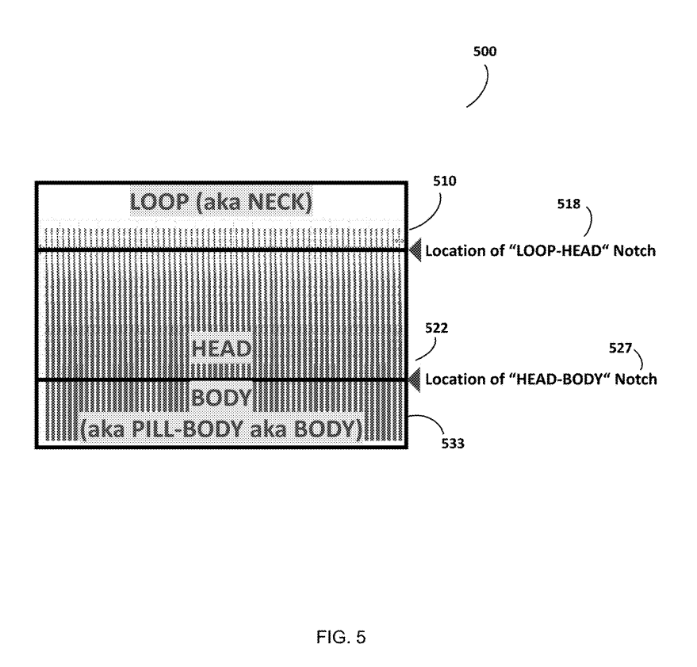
Top-down view of substrate

Slide 11
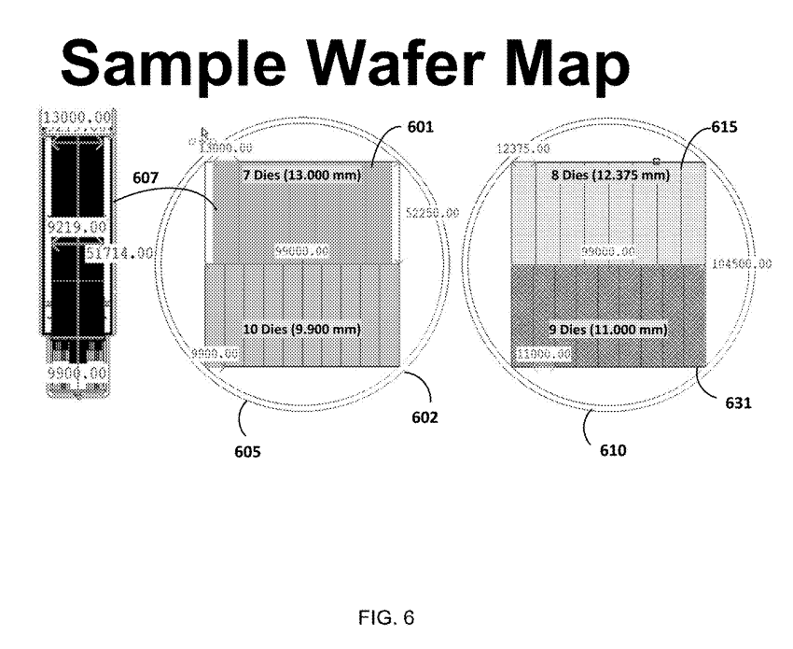
Sample Wafer Map

